Slide 1
Notes:
Good afternoon, esteemed judges, fellow participants, and guests I am jake ross…... Today, we are excited to present to you a groundbreaking solution that promises to revolutionize the poultry farming industry.
There are 23 billion chickens on earth right now. Over 90 percent of these require human technology to survive. Most modern farming practices rely on unstainable techniques. We are Geowarmth Poultry Solutions, a ground source heating system aimed at sustainable poultry farming.

Slide 2
The Problem
50,000 POULTRY FARMS IN U.S.
35% OF YEARLY OPERATING COSTS
PROPANE AND NATURAL GAS
INTRICATE VENTILATION OF $7,500 ON AVERAGE
360 MILLION TONS OF GREENHOUSE GASSES
Notes:
Summer
Poultry farming is a vital sector within the U.S., with nearly 50,000 farms across the nation and continual growth on the horizon. However, a significant challenge these poultry farms face is the high operating costs associated with maintaining the temperature of chicken houses. Currently, over 35% of yearly operating costs for farms are attributed to heating expenses. Additionally, the industry standard of propane and natural gas heating systems contributes to poor air quality and significant greenhouse gas emissions, amounting to over 360 million tons annually. Intricate ventilation systems must be present in each individual house in order to prevent chicken fatalities caused by poor air quality. Overall, heating related costs are a high expense for farmers and the environmental impacts are a major point of concern.

Slide 3
The Solution
Ground-source heating system for broiler chicken farms
At a cost of $130,000 on average per system
End-to-end support
Notes:
JD
Here's where we come in– At GPS we provide a cost saving and environmentally friendly system. Its what we do.. THESE innovative ground-source heating systems are tailored specifically for broiler chicken farms. Priced at an average of $130,000 per system (that’s a one-time cost, as opposed to spending thousands of dollars a year on propane or the upkeeping a fancy ventilation system), with that said GPS offers a fully customizable and cost-effective alternative to the traditional heating methods of propane. Our comprehensive service includes consultation with farmers, planning the system, installation of the unit, and ongoing maintenance.. By harnessing the natural heat from the ground, we not only save farmers money, we save the planet.

Slide 4
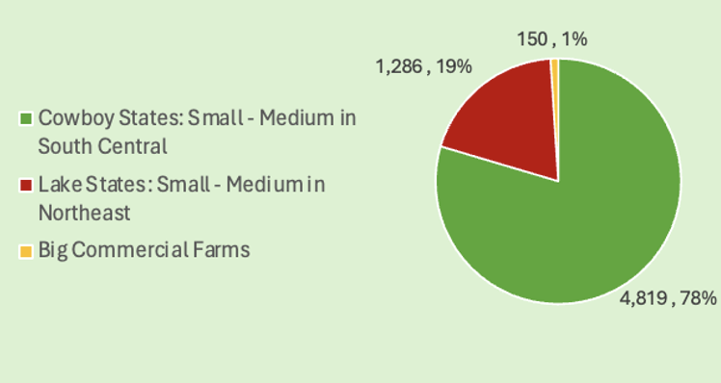
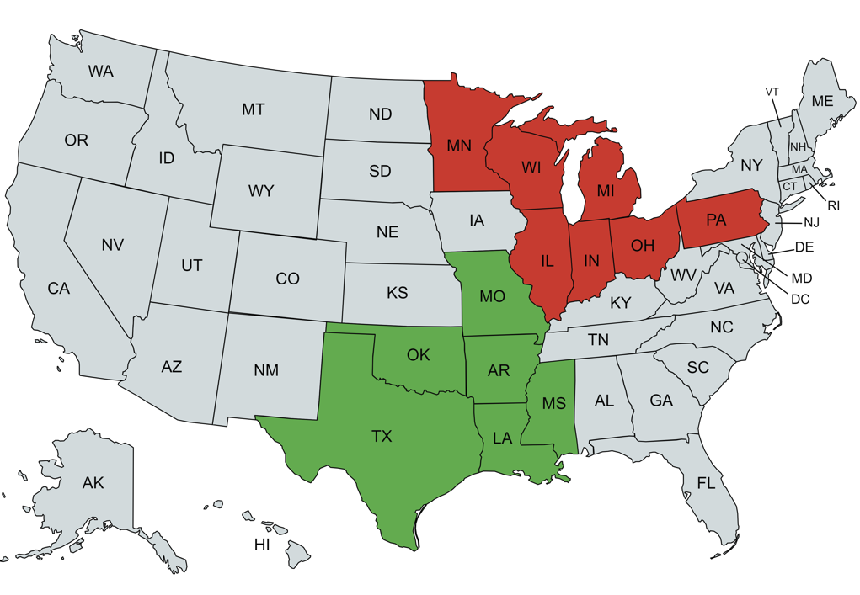
Customer Profile
Target Markets Segmentation based on Number of Farms
Segment Locations
Notes:
Through our extensive research and market analysis we identified three segments consisting of over 6,200 broiler farms. Our primary two segments consist of the “Cowboy States” with over 4,800 farms and “Lake States” with over 1,200 farms Located in both the South central and great lake regions of the US. These two segments are farms that are independently owned and operated and have at most 130,000 broiler chickens. These Segments are well-suited for us due to a high density of broiler farms and favorable ground temperature, which help to excel the effectiveness of geothermal pumps. These attributes make these target markets more susceptible to investing in our services. Additionally, we will be targeting large commercial-grade farms for they have been known to have experimental plants where they seek out testing for new technologies and farming techniques with over 150 farms.

Slide 5
Acquisition Plan
Marketing Mix
Traditional Marketing
Magazine Ads
Personal Selling
Trade Shows
Notes:
We plan on attracting customers through traditional marketing channels like radio ads and magazines such as Practical Poultry and the Progressive Farmer. We will target customers through Personal selling which involves sending sales-people to farms to establish a relationship. We will utilize trade shows such as the Western Farm Show in Missouri and Farm Science Review in Ohio. We will provide cost savings through the cost of ownership method where Farmers are expected to recoup initial costs within around 10 years, while the lifespan of our system is around 25 years. We will also educate the farmers about the available tax credits of up to 30%.

Slide 6
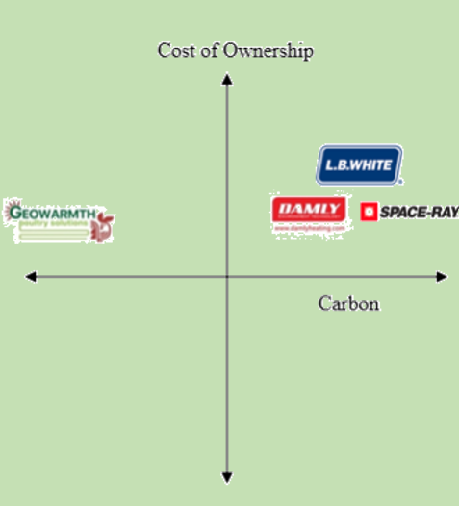
Market and Industry Demographics
Competitive Advantage
Industry Demographics
Gov’t Incentives
Eco-friendly
Cost Of
Ownership
High PR
Poultry & Beef
Political Ideologies
Notes:
Tacinelli

Slide 7
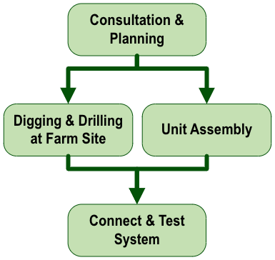
Business Operations and Risk
Managing Risk
Simplified Process Map
Risk
Mitigation
Proactive Approaches
Warranty on Defects
Notes:
Grady

Slide 8
Financial Profile
Profitable by Year 4
Liquidity
Current ratio: 5.89 by year 5
Profitability
Solvency
Net profit margin: 7.69% by year 5
Times Interest Earned: 3.84 by year 5
Notes:
Jake R.
A brief overview of financial performance projects the company to be profitable by year 4.
Our liquidity ratios paint a picture of robust financial health, with our current ratio consistently on the rise, projected to be 5.89 in year 5, far surpassing the industry average of 1.72. This demonstrates our exceptional ability to meet short-term obligations with ease.
Our profitability ratios highlight our operational efficiency. Despite challenges in earlier years, our net profit margin is projected to be 7.69% in year 5, showcasing our dedication to expense management and sustainable growth. Our commitment to optimizing production processes and pricing strategies should enable us to reach these projections.
Long-term solvency is highly important for the repayment of our long-term debts. Our times interest earned is an important metric considering the amount of debt acquired over the years. This value reaches 3.84 by year 5 and demonstrates strong capabilities toward continuing long-term solvency.

Slide 9
Valuation
Financial Value
3.8 Million
$500,000
13%
Stake in Company
Amount of Financing Sought
Notes:
Based on our financial performance, market opportunity, and comparable company analysis, we have determined that GPS is valued at 3.8 million dollars. Today, we are seeking 500,000, in exchange for a 13% stake of our company.

Slide 10
Capital Allocation Strategy
Investment in equipment
Hiring of skilled workers
Quality of work to secure reputation
Notes:
Summer
I'm sure our judges are asking themselves, "what will they do with 500k of our money?", we have chosen to focus on 3 key areas of interest. Firstly, we have prioritized investing in the most reliable equipment to enhance efficiency and productivity in our operations. Secondly, we have focused on recruiting skilled workers to drive innovation and excellence, allowing us to recognizing the long-term benefits of a talented workforce. This focus is shown in our location central to many universities with agricultural programs as well as competitive compensation packages offered to attract and retain top talent. Our 3d area of focus is quality of work, which we believe will allow us to secure a reputation of reliability and attention to detail. Rigorous quality checks and customization options are implemented at every stage to ensure customer satisfaction and to further enhance our competitive advantage.

Slide 11
Notes:
By embracing ground source heating, poultry farming takes a vital step towards reducing environmental impact. When it comes to sustainable poultry farming, we hope you will all agree when we say GPS is the solution. After all, its in our name.

Slide 13
Appendix

Slide 14
Management
Organization Chart

Slide 15
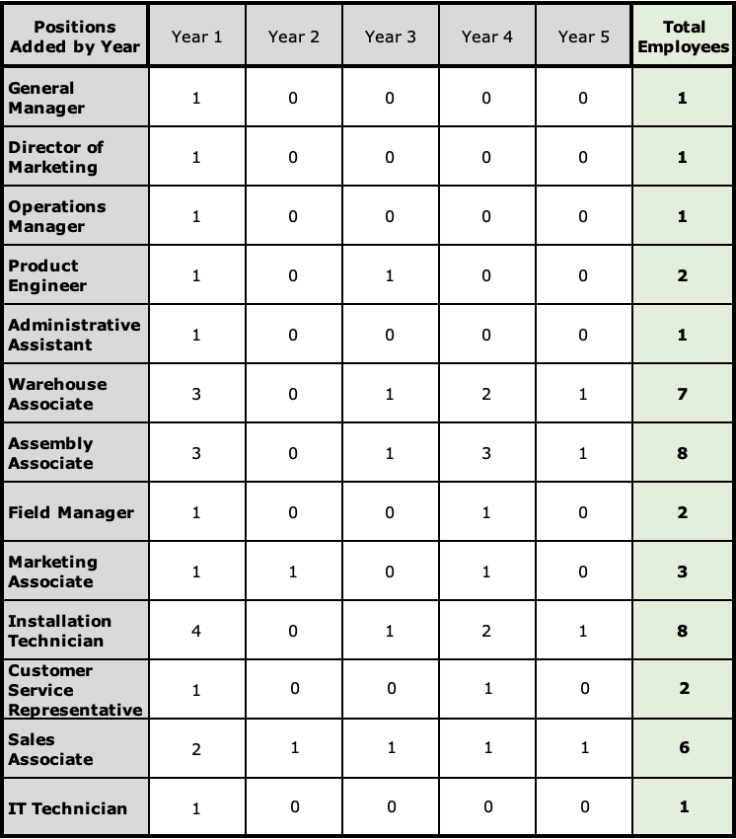
Management
Employees added each year

Slide 16
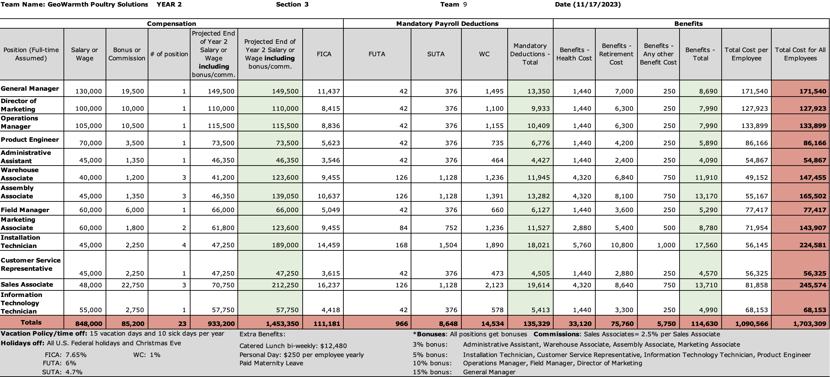
Management
Payroll Information

Slide 17
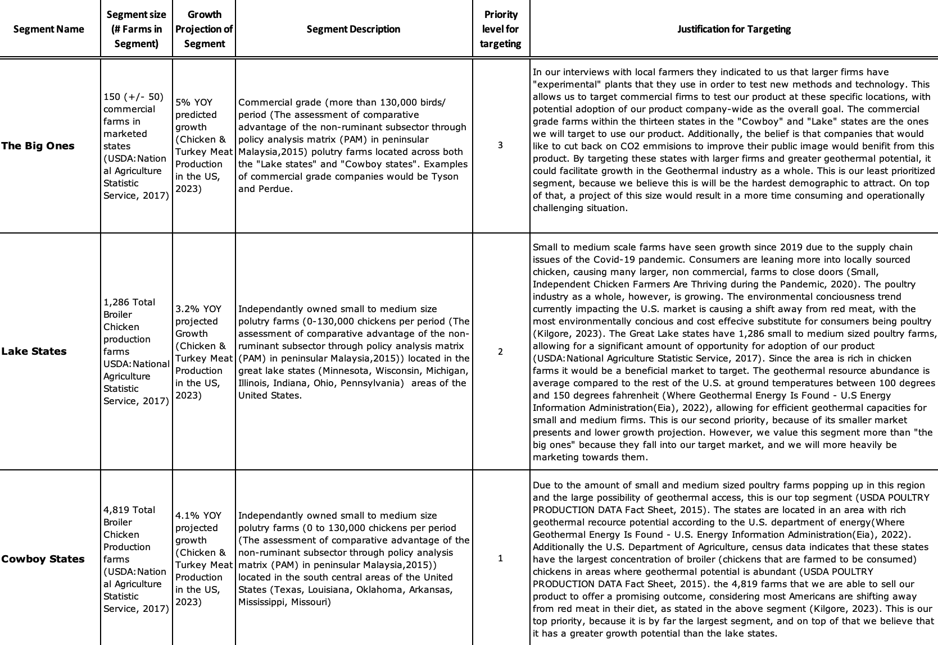
Marketing
Segmentation and Positioning

Slide 18
Marketing
Market Quantification

Slide 19
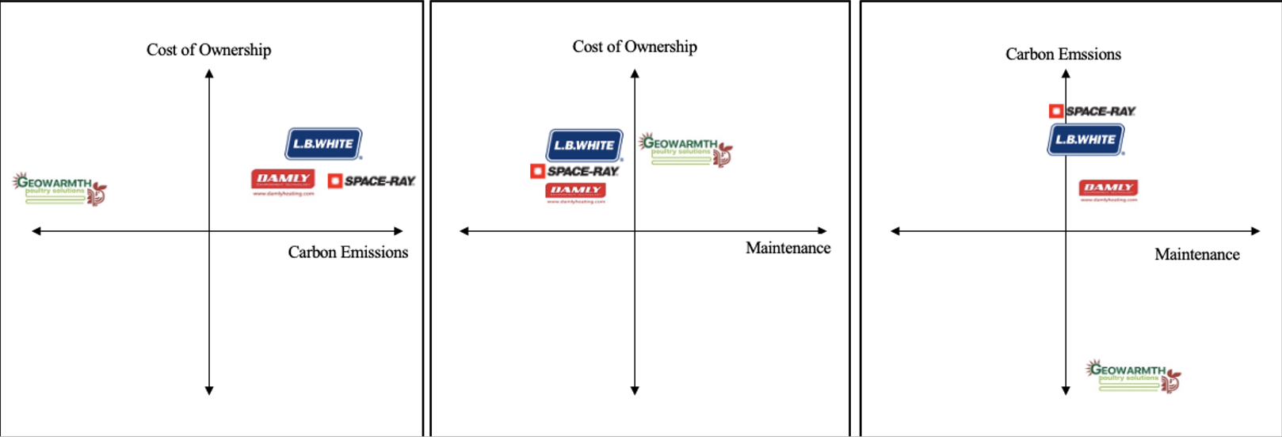
Marketing
Positioning

Slide 20
Marketing
Marketing Mix

Slide 21
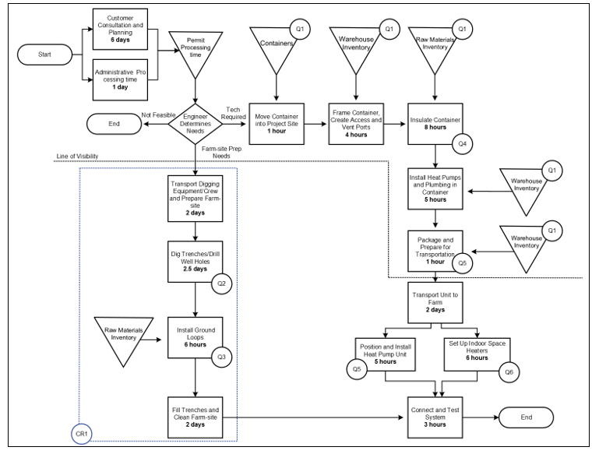
Operations
Process Map

Slide 22
Operations
Quality checks

Slide 23
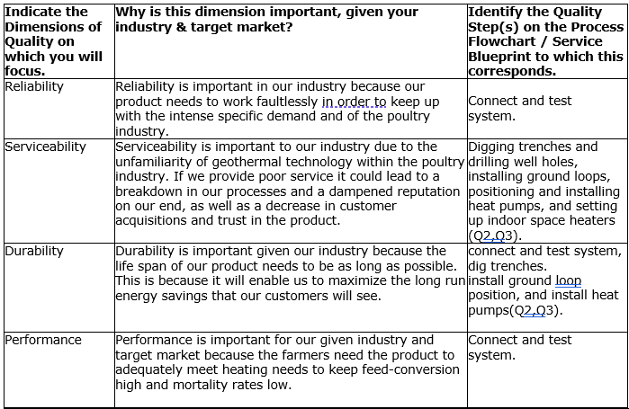
Operations
Quality assurance

Slide 24
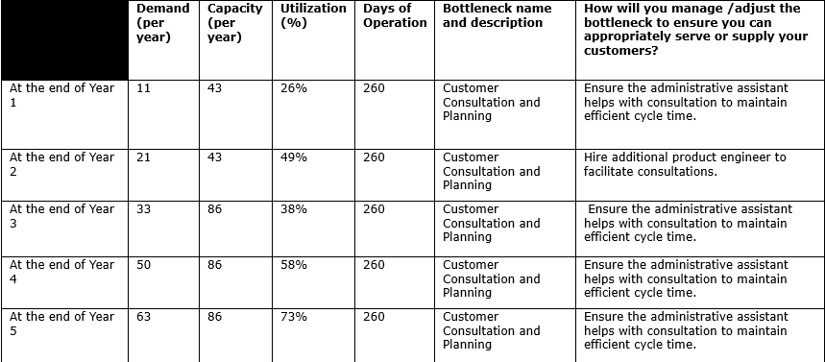
Operations
Capacity planning

Slide 25
Finance
Income
Statement

Slide 26
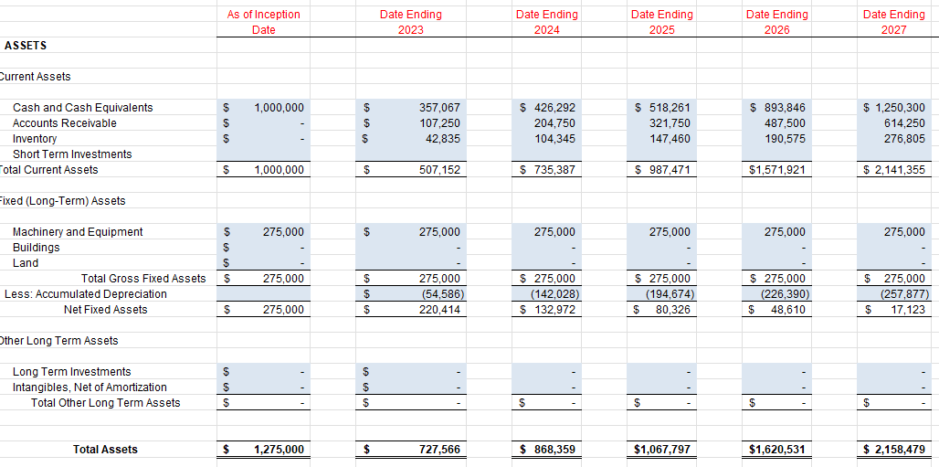
Finance
Assets Balance Sheet

Slide 27
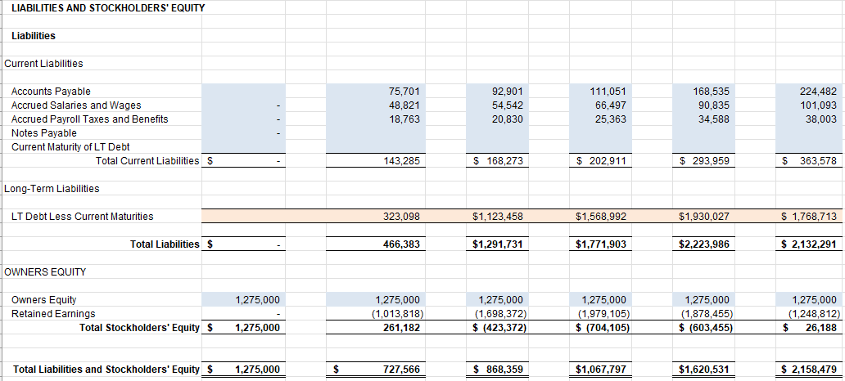
Finance
Liabilities Balance Sheet

Slide 28
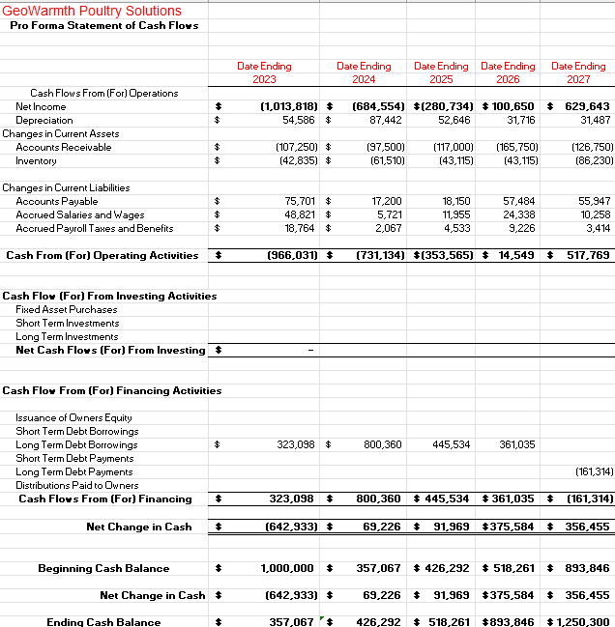
Finance
Cash Flows

Slide 29
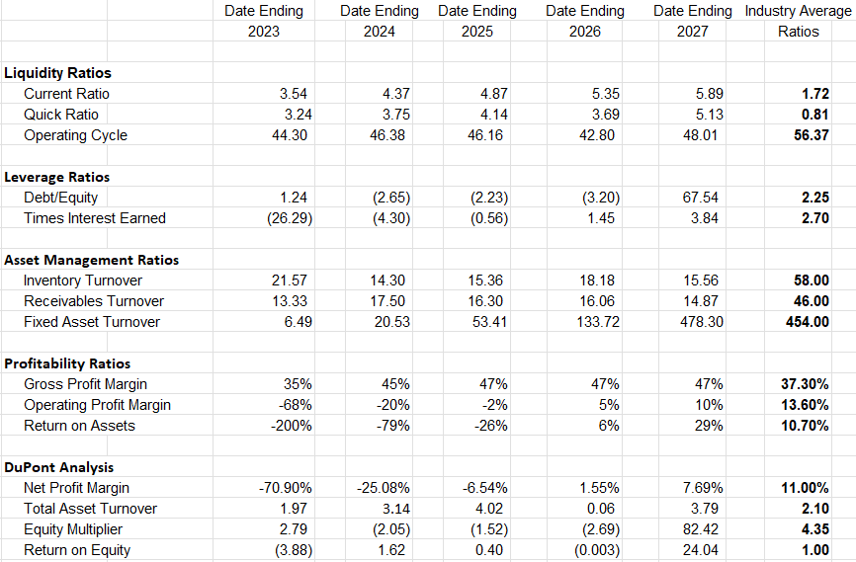
Finance
Ratio analysis

